Slide 1


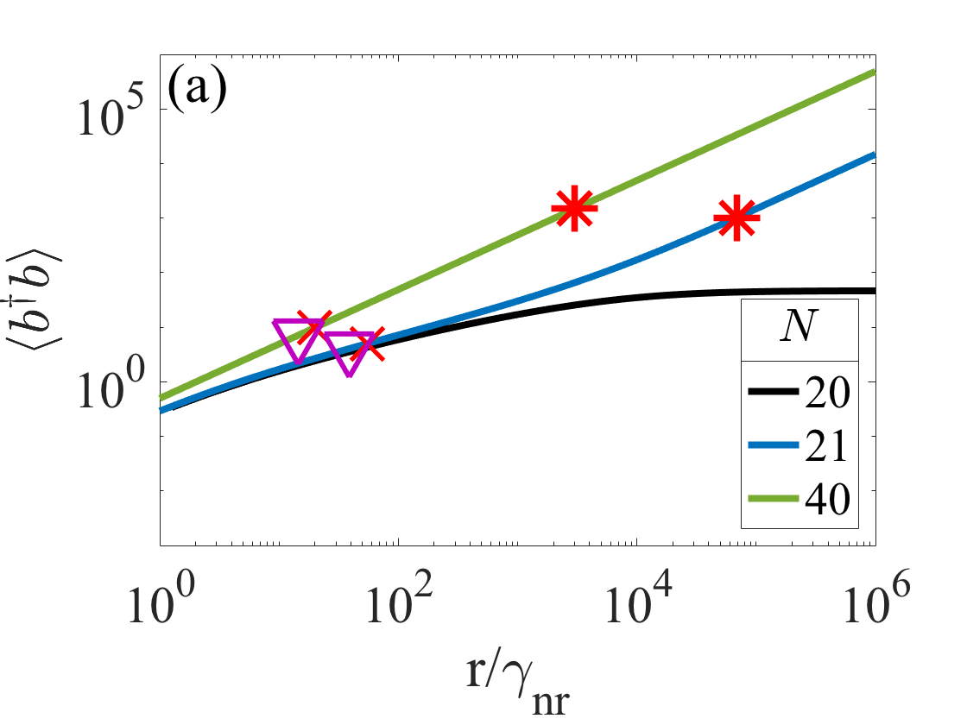
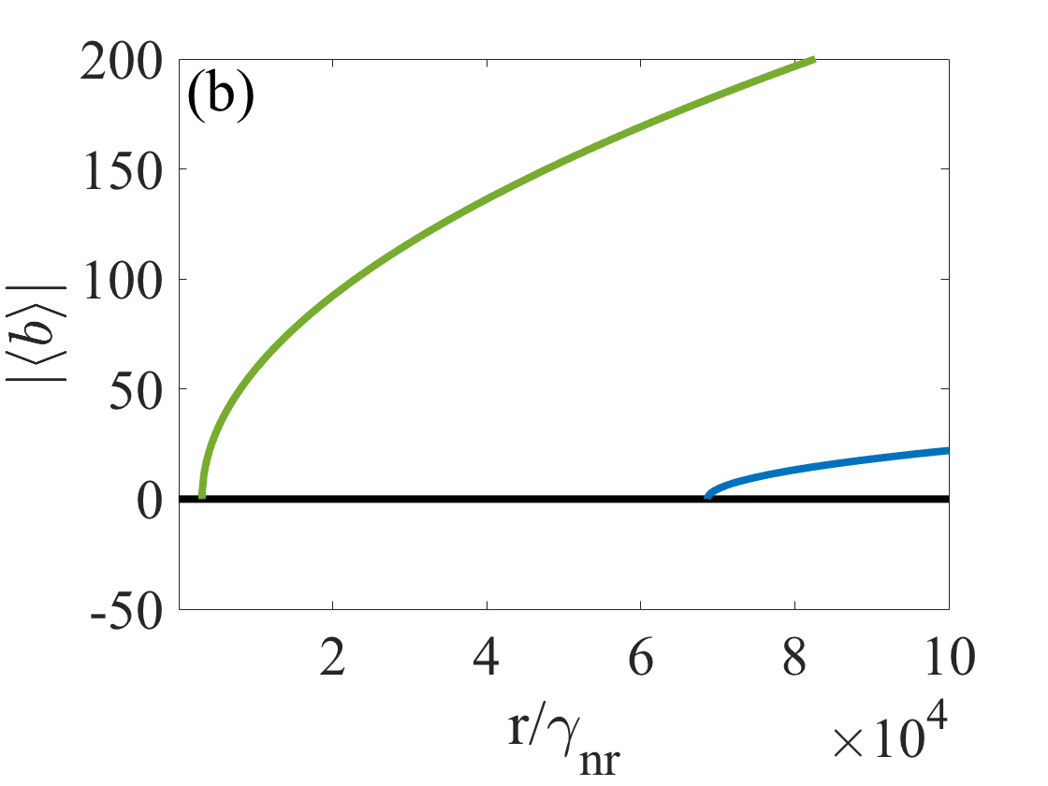
Laser thresholds in nanolasers
Mark Anthony Carroll
Additional Authors: Giampaolo D’Alessandro, Gian Luca Lippi, Gian-Luca Oppo and Francesco Papoff
Additional Institutions: University of Southampton & Universite ́ Côte d’Azur
Funder: University of Strathclyde
Abstract
For the past three decades debate has surrounded the existence of a threshold in nanolasers leading many to think that there are “thresholdless” laser devices. However, thanks to the development of a new quantum laser theory we now have the answer: Thresholds do exist for nanolasers!
Identifying the laser threshold in an ideal nanolaser
Photon Number
Coherent Field Amplitude
Project Description
Previous microscopic models employed to study nanolasers neglect the classical variables needed to describe coherence properties, i.e. laser emission. Macroscopic models neglect variables describing quantum fluctuations and can only give information above the laser threshold where nothing is know about the incoherent emission below threshold.
We combine quantum theory with dynamical systems methods to develop a new microscopic laser theory [1] that incorporates aspects unique to both classical and quantum theories thus bridging the gap between them.
Key Results
Nanolasers do have laser threshold with a well defined frequency
Critical number of emitters required for a device to be capable of lasing
We find a non-classical regime of emission that precedes the lasing regime
Future Work
Proposed a simple scheme to exploit antibunching (photon-number squeezing) with low power supply as a source of non-classical light
[1] Carroll, M. A., D’Alessandro, G., Lippi, G. L., Oppo, G. L., & Papoff, F. (2021). Thermal, quantum antibunching and lasing thresholds from single emitters to macroscopic devices. Physical Review Letters, 126(6), 063902.

