Slide 1



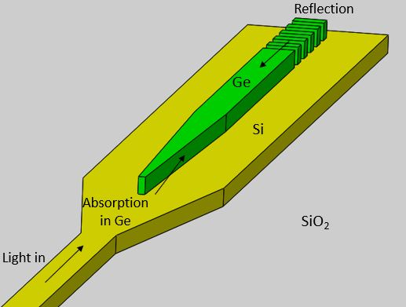
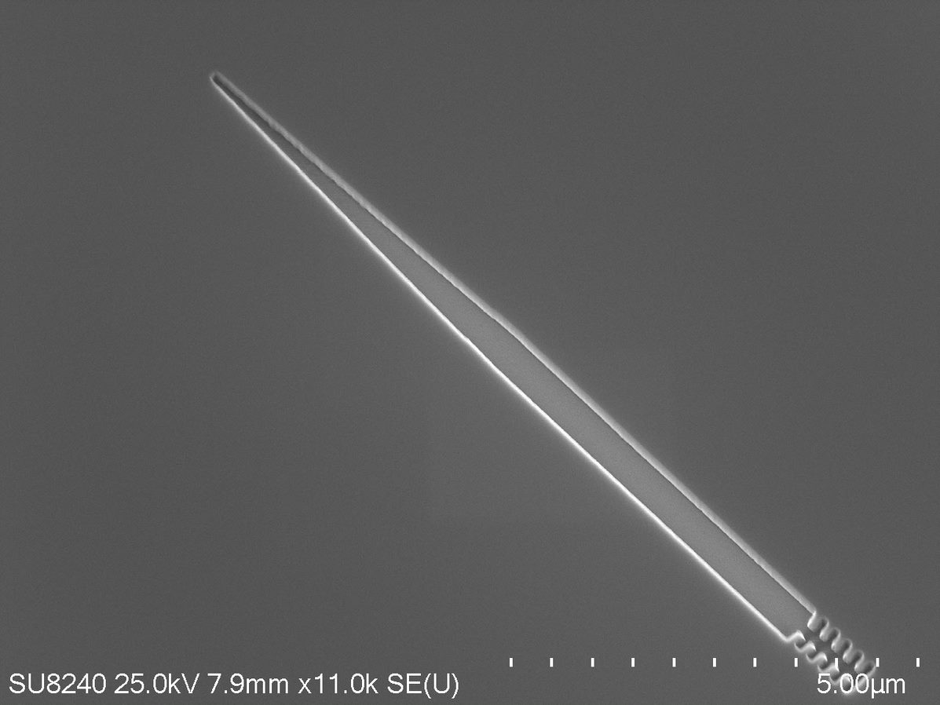
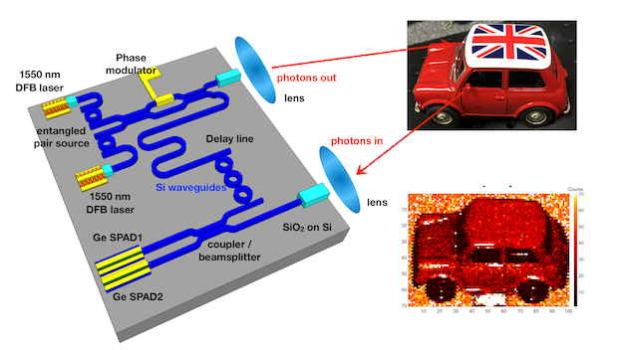
Waveguide-integrated Ge-on-Si single photon detectors (SPADs)
Conor Coughlan, University of Glasgow
Additional Author(s): Ross Millar, Douglas J. Paul
Funder: EPSRC CDT in Intelligent Sensing and Measurement (CDT-ISM)
Abstract
Quantum technologies such as quantum key distribution (QKD) and light detection and ranging (LIDAR) have the potential for ultra-secure communications and highly accurate and precise rangefinding. The ability to guide single photons from an optical fibre into a chip, and subsequently detect them with high efficiency is critical to these proposed quantum technologies. Thus, developing highly efficient single photon detectors at 1550nm based on Ge-on-Si provides a low-cost, compatible and safe method to achieve widespread adoption of these technologies.
Ge-on-Si waveguide-integrated SPADs
From concept..
…to fabrication
Fig 1: proposed Ge-on-Si waveguide-integrated SPAD
Fig 2: fabricated design for Ge selective growth
Project Description
Conventional single photon detectors are made from Si, where due to a bandgap of 1.1eV, only will absorb light up to 1000nm in wavelength, reducing its ability to detect in the telecoms bands of 1310nm and 1550nm. To extend to longer wavelengths, a different material must be used. Ge fits this requirement, with a bandgap of 0.7eV, and is also a well-studied material, CMOS compatible and cheaper compared to its competitors. Developing Ge-on-Si single photon detectors at 1550nm has the potential to create cheap, robust and highly efficient detection methods without stringent cooling conditions. This project aims to model, fabricate and characterise waveguide-integrated Ge-on-Si SPADs to achieve this.
Key Results, Conclusions & Impact
Optical and electrical simulations show promising results
Fabrication is ongoing, with final prototype expect in the coming months
Development of these devices will allow contribute towards adoption of an Si/Ge platform for single photon detection in quantum technologies
Fig 3: Proposed integration of Ge-on-Si waveguide SPADs in a quantum LIDAR measurement
Refs: Vines et al., Nature Comms, 2019, DOI: 10.1038/s41467-019-08830
http://userweb.eng.gla.ac.uk/douglas.paul/

