Slide 1

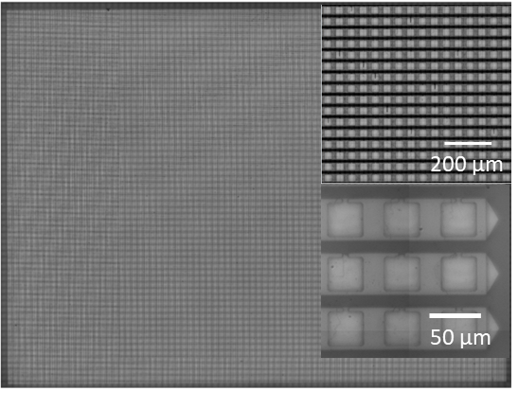
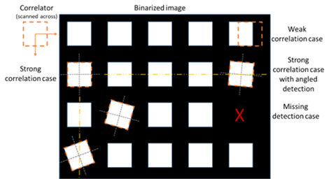
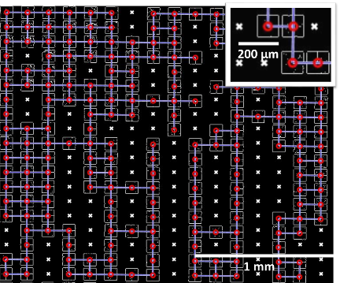
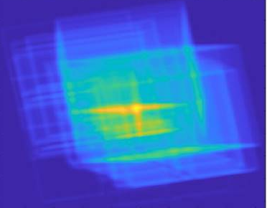
High-accuracy automated inspection method for transferred devices
Eleni Margariti
Additional Author(s): Dimitars Jevtics, Benoit Guilhabert, Martin D. Dawson, Michael J. Strain
Funder(s): National Manufacturing Institute Scotland (NMIS), Scottish Research Partnership in Engineering (SRPe)
Industry Sponsor: Fraunhofer UK
Abstract
The integration of opto-electronic devices from different material platforms allows the production of advanced systems with improved operating characteristics and low power consumption. A main challenge in the mass production of these devices is to rapidly assess the manufacturing process. To address this challenge, we developed an image processing method which can be used for device identification and positional mapping.
Analysis method and processing
Fig.1. QVGA micro-LED device (320x240 elements) with a close up snapshot of the stitched elements
Fig.2. Schematic representation of the cross correlation with reconstructed device after the correlation for multiple angles
Fig. 3. Snapshot of the printed devices after processing, highlighting the centers of each device (red dots), the missing devices (white cross) and the pitch values (blue lines).
Project Description
A dynamic microscopy system is used to capture high resolution, small field of view sub-images and stitched them together to form a complete image of the sample, typically covering cm² areas. By using an image processing method based on the cross correlation, spatial center position of devices, their local rotation and yield (i.e. device present or not) was assessed for sets of thousands of devices with sub-micron accuracy. The measured results can be compared to the photolithography mask file used for this microfabrication, both prior to any printing process (for validation) and after, for the computation of printing defects.
Key Results, Conclusions, Comments, Impact
This tool is designed to measure the accuracy of mass printing processes with a sub-micron precision, using standard optical microscopy elements and computer vision.
Demonstration of the method in a very challenging roll-printed chip consisting of 4000 micro-LEDs.
Initial results shows that the average error value of the technique is 0.06 ± 0.26 μm for device with 320x240 elements.
Broadly applicable in high throughput manufacturing process flows for heterogeneous integration and semiconductor devices.
Refs & links
John McPhillimy, Dimitars Jevtics, Benoit J. E. Guilhabert, Charalambos Klitis, Antonio Hurtado, Marc Sorel, Martin D. Dawson, and Michael J. Strain ACS Applied Nano Materials 2020 3 (10), 10326-10332.
M. J. R. Heck, J. F. Bauters, M. L. Davenport, J. K. Doylend, S. Jain, G. Kurczveil, S. Srinivasan, and J. E. Bowers, “Hybrid Silicon Photonic Integrated Circuit Technology,” IEEE J. Sel. Top. Quantum Electron. 19, 6100117–6100117(2013).

