Slide 1

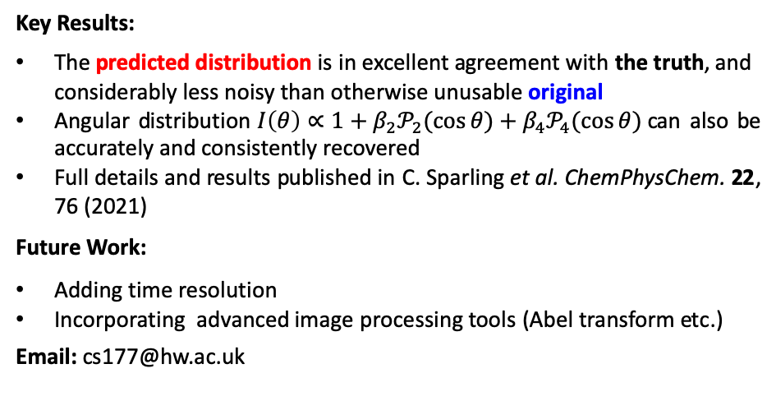
Artificial Neural Networks for Noise Removal in Data-Sparse Photoelectron Imaging
Chris Sparling^{[a]} & Alice Ruget^{[a]}
Additional Author(s): Nikoleta Kotsina,^{[a]} Jonathan Leach^{[a]} and Dave Townsend^{[a, b]}
Additional Institution(s): ^{[a]} Institute of Photonics and Quantum Sciences and ^{[b]} Institute of Chemical Sciences
Funder(s): Leverhulme Trust, Carnegie Trust, EPSRC and HWU
Abstract:
We present the first artificial neural networks (ANNs) for the removal of Poissonian noise in charged particle imaging experiments. Our results reveal an extremely high level of performance, with the ANNs transforming images that are unusable for any form of quantitative analysis into statistically reliable data.
a)
b)
c)
25 of 25
1 of 25
ANN prediction
Before
ANN
After
ANN
Project Description:
Much of the research studying gas phase molecules and their dynamics relies on detecting and imaging ions/electrons following a reaction. Although imaging methods have a multiplexed advantage of recording both energy- and angle-resolved data simultaneously, they are inherently susceptible to Poissonian noise, which is notoriously difficult to filter out. We have developed an ANN to predict the ‘true’ final outcome of an experiment from a small and noisy initial sample of data. A typical experimental image is shown in a) and is slowly acquired over 25 scan cycles. A single scan image is shown in b). Using our ANN, we can produce c) from b) and accurately recover reliable experimental data from otherwise unusable images. We have successfully demonstrated the ANNs robust performance on both simulated and real experimental data, the latter being shown here.
Key Results:
The predicted distribution is in excellent agreement with the truth, and considerably less noisy than otherwise unusable original
Angular distribution$I\left(θ\right)∝1+β_{2}𝒫_{2}(\cos{θ)}+β_{4}𝒫_{4}(\cos{θ)}$can also be accurately and consistently recovered
Full details and results published in C. Sparling et al. ChemPhysChem. 22, 76 (2021)
Future Work:
Adding time resolution
Incorporating advanced image processing tools (Abel transform etc.)
Email: cs177@hw.ac.uk

