Slide 1
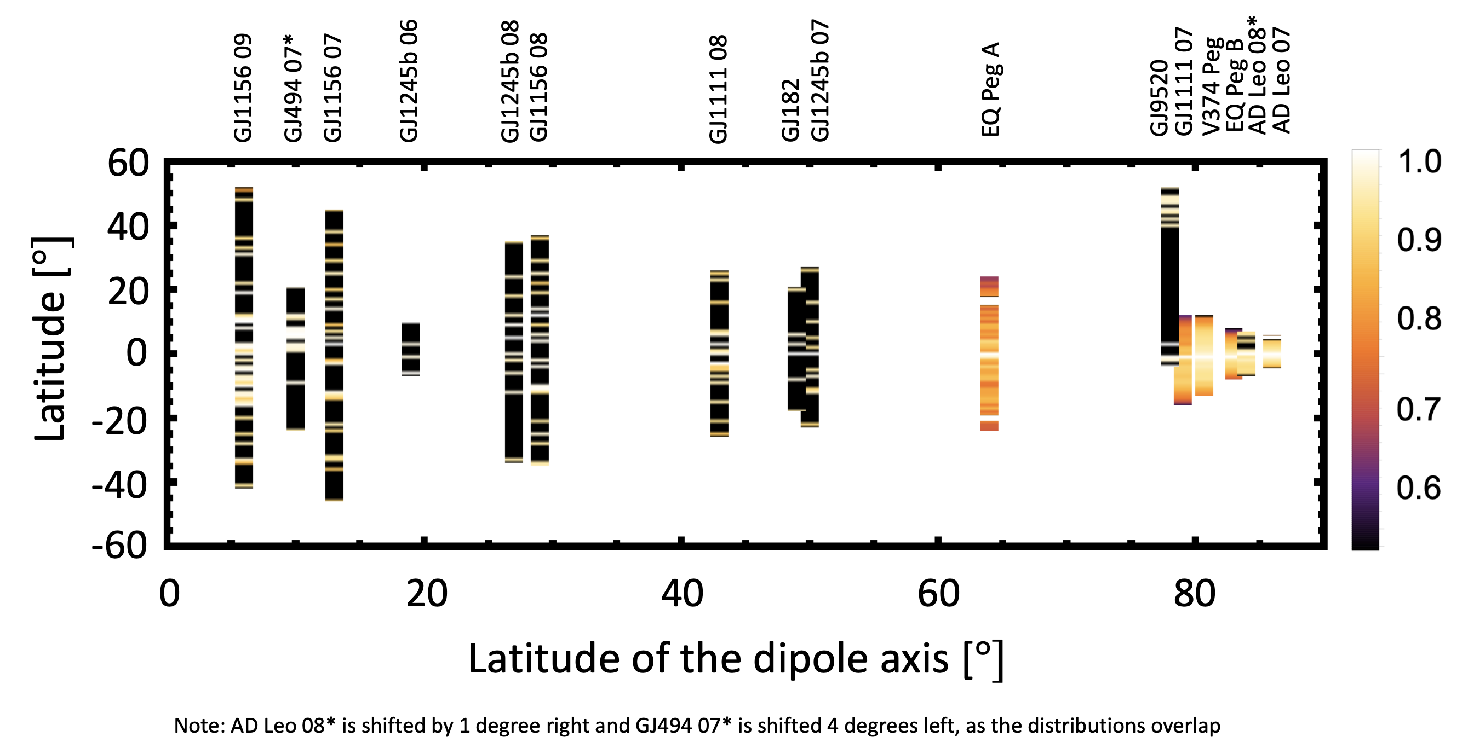
Modelled prominence mass distributions on M-dwarfs
Rose F.P. Waugh
Additional Author(s): Moira Jardine
Funder(s): STFC
Abstract
We predict the possible locations of prominences (hydrogen clouds) around a set of M-dwarfs. Observational data of the stellar magnetic field is used to calculate stable points in the field (prominence locations). From this we calculate the prominence mass. Their locations depend on field structure thus, they may be useful in helping to reconstruct coronal field structure, if properly understood.
Mass that can be supported depends strongly on magnetic field geometry)
Project Description
We used observed ZDI maps (which provide the magnetic field at the stellar surface) to reconstruct the coronal magnetic fields in a set of Mdwarfs, by assuming a potential field. With this we predict the prominence locations as mechanical stable points. The prominence mass is calculated as the maximum that could be supported at a stable point. From the figure we see field structure has a strong influence over the range of prominence latitudes. Stars with highly inclined dipoles to their rotation axis support higher latitude prominences than those with aligned dipole and rotation axes.
Key Results, Conclusions, Impact
Young, rapidly rotating stars with aligned dipole and rotation axes will support more prominence mass than those with more tilted dipoles.
Prominences could be found on all the maps in our sample, suggesting they’re common features of these stars.
This work (and the more detailed work in the paper in progress) will help inform observers about the conditions needed to not only support these prominences but also for them to be visible to us (cross the stellar disc, as they’re seen in absorption as they transit the disc).
Refs associated paper in progress

