Slide 1


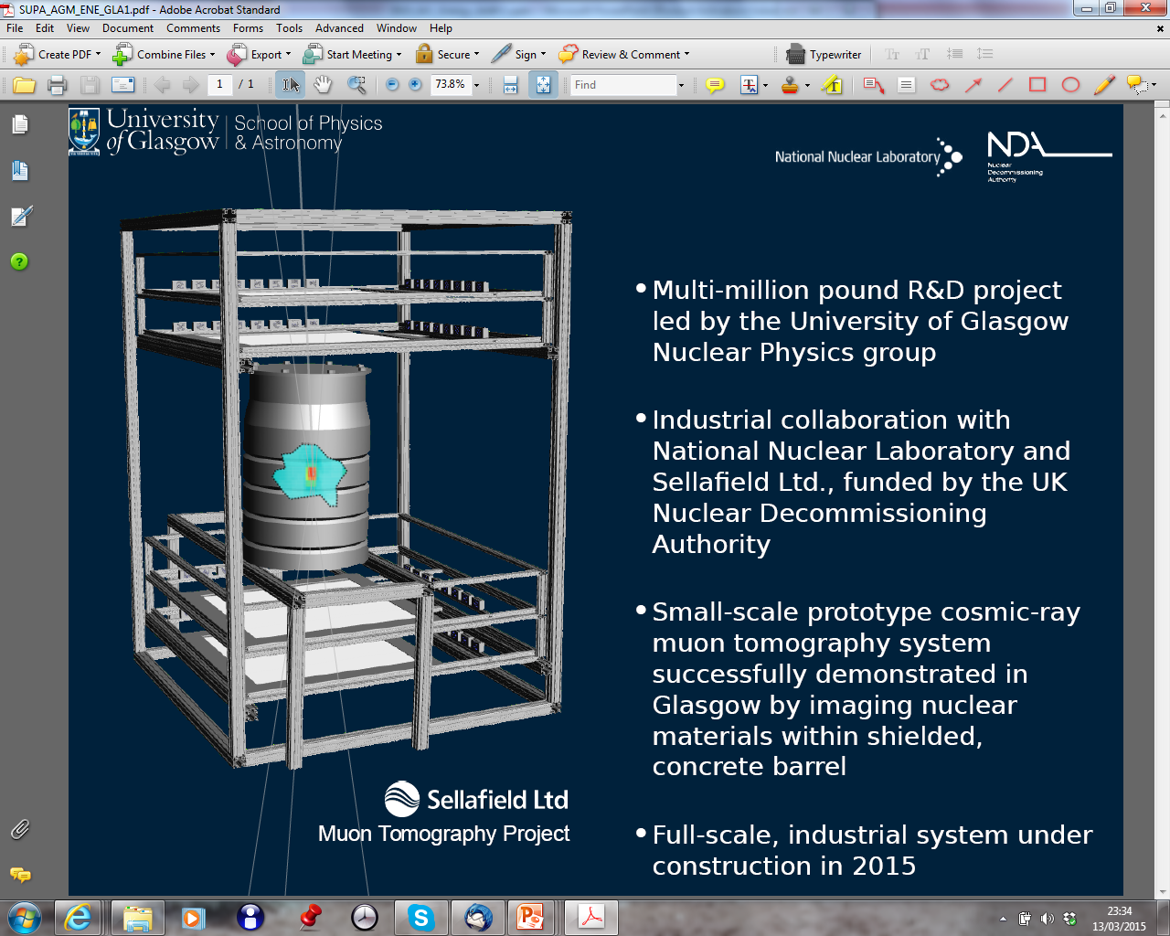
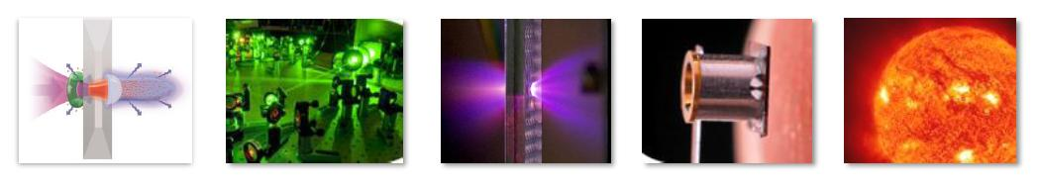
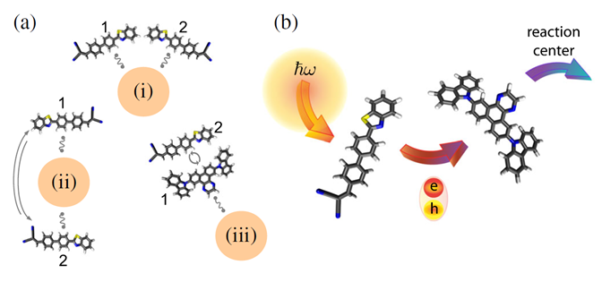
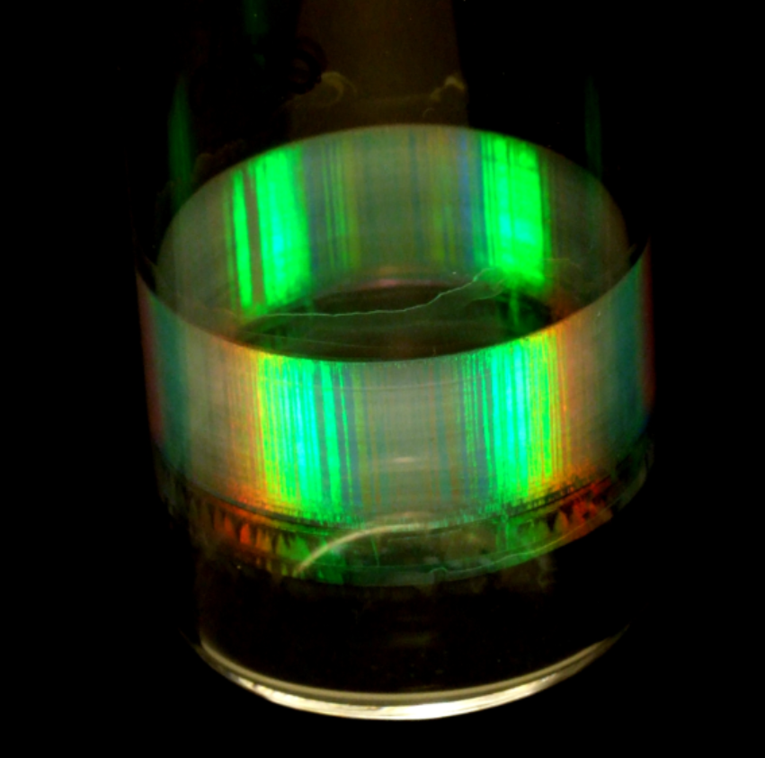
SUPA Energy Theme
Theme Management Committee:
Paul Clegg (Edinburgh) – Theme Leader
Murilo da Silva Baptista (Aberdeen)
Steve Reynolds (Dundee)
David Hamilton (Glasgow)
Tadhg O’Donovan (Heriot-Watt)
Ifor Samuel (St. Andrews)
Zheng-Ming Sheng (Strathclyde)
Des Gibson (UWS)
Presenter:
David French (Edinburgh)

Slide 2
Theme overview
~25 academics, ~30 postdocs, and ~40 PhD students across the 8 SUPA institutions with energy as a core element of their research
Almost all members of this theme are members of other themes

Slide 3


Solar physics
Highlight
The Center for Organic Photonics and Electronics Research at Kyushu University (OPERA) recently achieved the creation of materials exhibiting highly efficient thermally activated delayed fluorescence (TADF). Yields efficient conversion of triplet excitons into singlet excitons for application in photonic devices such as organic light-emitting diodes (OLEDs).
Led to application for EPSRC Core to Core grant – PI Samuel (St.A) – linking St. Andrews, Kyushu and some European partners – with the aim of developing understanding and devices; £1M.
http://gow.epsrc.ac.uk/NGBOViewGrant.aspx?GrantRef=EP/R035164/1

Slide 4

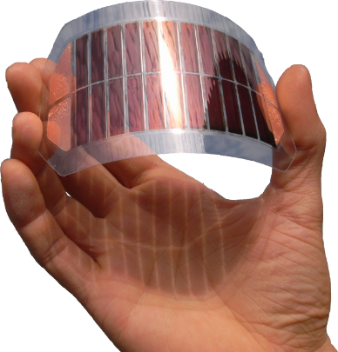
Solar physics
Significant grant funding:
EPSRC core to core grant - new light emitting materials and devices – linked to Centre for Organic Photonics and Electronics at Kyushu University, Japan (St.A); £1M; 2018 - NEW
Innovate UK Energy Catalyst: Integration of Thermal Storage with Solar Collector Design (H-W & Soltropy Ltd); £200k; 2017-18
High profile publications:
Nature Communications (2018) – Polymer membrane lasers (Samuel, St.A)
Nanoscale (2017) – Efficiency of quantum dots in dye sensitized solar cells (Samuel, St.A)
ACS Nano (2017) – Emergent Properties of an Organic Semiconductor Driven by its Molecular Chirality (Samuel, St.A)
Materials Chemistry A (2017) - Air exposure induced recombination in PTB7:PC71BM solar cells (DU, St.A)
Applied Optics (2018) – Diffuse scattering and collection efficiency (DU)

Slide 5

Fusion and legacy nuclear waste
Highlight
McKenna, Nealy, Gray, King (SU)
Strathclyde team describes a hybrid scheme where protons are accelerated in an ultra-thin polymer foil, tens of nanometres thick. The laser pulse generates a plasma from the polymer and accelerates protons to speeds in the 100MeV range, which is useful for practical applications (inc. fusion). This work promises to lead to much more compact ion sources than have previously been available. -- Nature Communications, 2018

Slide 6

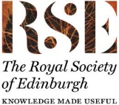

Fusion and legacy nuclear waste
Prizes and esteem:
Strathclyde becomes a member of Cockcroft Institute (SU)
Paul McKenna (SU) Member of STFC Science Board & Member of EPSRC Capital Infrastructure SAT
Significant grant funding:
EPSRC grant: Parametric Wave Coupling and Non-Linear Mixing in Plasma (SU) £760k; 2017 - 2020 - NEW
EPSRC grant: Nonlinear Optics and Dynamics in Relativistically Transparent Plasmas, (SU) £1M; 2017-2021 - NEW
Zheng-Ming Sheng, European Commission Horizon2020 MSCA-IF-2016, Exploring Laser Interaction with Matters in the Quantum Electrodynamics Regime, (SU) 200keuro; 2017 – 2019 - NEW
High profile publications:
Nature Communications (2018) – Laser-driven transparency-enhanced hybrid acceleration scheme (McKenna, SU)
Phys. Rev. Lett. (2018) - Multistage coupling of laser-wakefield accelerators with curved plasma channels (Sheng, SU)

Slide 7
Storage and Lighting
Highlight
Work by Thijssen (Edin) and collaborators comparing structured media for templating solid state electrolytes
Published: Energy & Environmental Science 2018
Building block for current research as part of EPSRC Energy Materials network

Slide 8
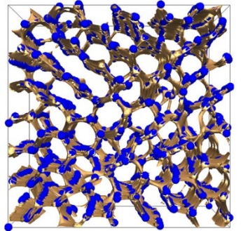
Storage and Lighting
Prizes and esteem:
Jan Skakle (Abdn) – made first female head of Royal Society of Chemistry Solid State Group
Significant new grant funding:
EPSRC network grant - Hexagonal perovskites (for SOFC applications); £27K (Abdn); 2018 - NEW
Leverhulme award – Hexagonal perovskites (for SOFC applications); £150K (Abdn); 2018 – 2020 – NEW
High Profile Publications:
Energy & Environmental Science (2018) – Comparisons of bijels and periodic porous media for Li-ion batteries (Thijssen, Edin)
Materials Horizons (2018) – Direct transformation of bijels into composite electrolyte for battery applications (Clegg, Thijssen, Edin)
J. Materials Chem. A (2018) – Crystal Structure and Electrical Properties of Oxide Ion Conductor (Skakle & Mclaughlin, Abdn)
Chemistry of Materials (2017) – Relationship between the Structure and Conductivity of the Novel Oxide Ionic Conductor (Skakle & Mclaughlin, Abdn)

Slide 9
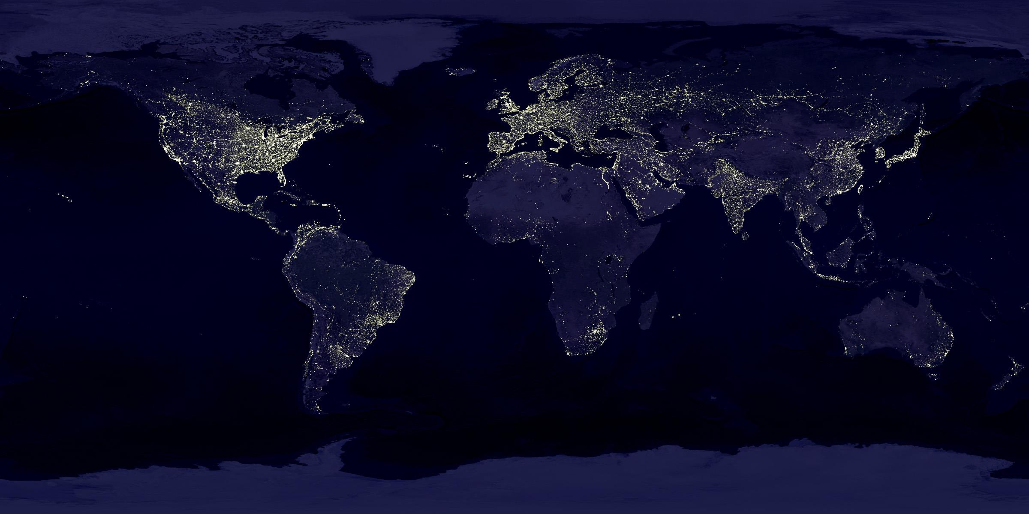
Summary
Flourishing new grant funding and growth in activity across our energy research portfolio
High impact publications across our theme topics
Collaborative work across SUPA in solar, lighting and nuclear; Links to several international projects and networks
Strong links to chemistry groups across the SUPA area
Emerging recent contribution to fuel cell research across SUPA
Two of three EPSRC Energy Materials networks led from Scotland
Notes:
9

