Slide 1



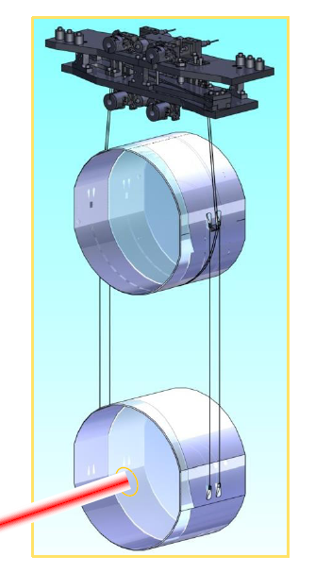
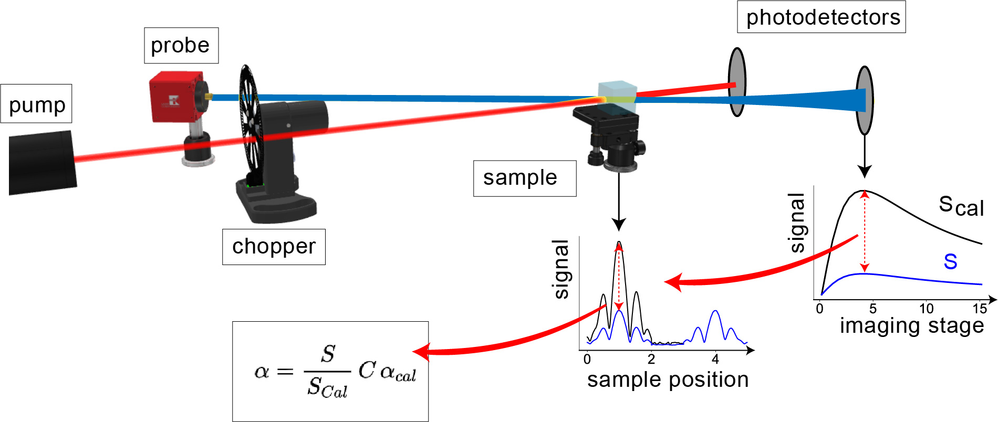
Keeping gravitational wave detectors cool
Ross Johnston
Additional Author(s): Graeme Mcghee, Iain Martin, James Hough, Sheila Rowan, Simon Tait
Additional Institution(s): IGR, LSC
Funder(s): Drever’s scholarship, STFC, Royal Society
Photothermal absorption setups
The key components of the photothermal common-path interferometry, leading onto the alignment and extraction of absorption as best suited for thin-film calibrations. In contrast the photothermal deflection as better suited for bulk samples, oscillates the blue beam across a substituted position sensor.
Abstract: Gravitational waves in their weakly-interacting nature are ideal time-capsules of distant astronomical events, devoid of signal absorption. Optical absorption of laser light is, however, a significant factor in the performance of the km-scale interferometers used to detect these waves. This work will highlight the origin of absorption and its reduction through novel mirror coatings, substrate measurement and treatments to indirectly reduce detector thermal noise, on multiple fronts.
Project Description
In addition to reduced thermal noise, low optical absorption is essential for both mirror coatings and the large mirror substrates. In the operational band of gravitational wave detectors lasers (1000-2000)nm absorption of the mirrors coatings - consisting of thin dielectric films - is generally a result of localized band gaps due to structural and stoichiometric defects. The latter also leads to dominant free-charge carrier absorption in the large silicon mirror substrates envisaged for use in future cryogenic detectors.
Standard spectroscopic methods are not suited for measuring these due to high reflectivity, scattering and low absorption found in the mirrors and instead photothermal refractive techniques must be used. As applied here, to qualify novel TiO₂:GeO₂ coatings for future detectors.
Conclusions
TiO₂:GeO₂ coating looks promising thus far and prepared to meet material down select, for upcoming detector upgrades.
Established absorption setup at Glasgow.
Future work
Work with vendors to characterise new substrates.
Assess absorption at cryogenics, in operational environment and in tandem with acoustic counterpart of mechanical loss.
To further understand the origins of absorption from the distribution of atomic energy levels, the geometry and stoichiometry of materials will be likewise assessed.
Refs: Thermal budget, Absorption targets, Optical Coatings, PCI, PTD, 3D optical simulation

